Slide 1
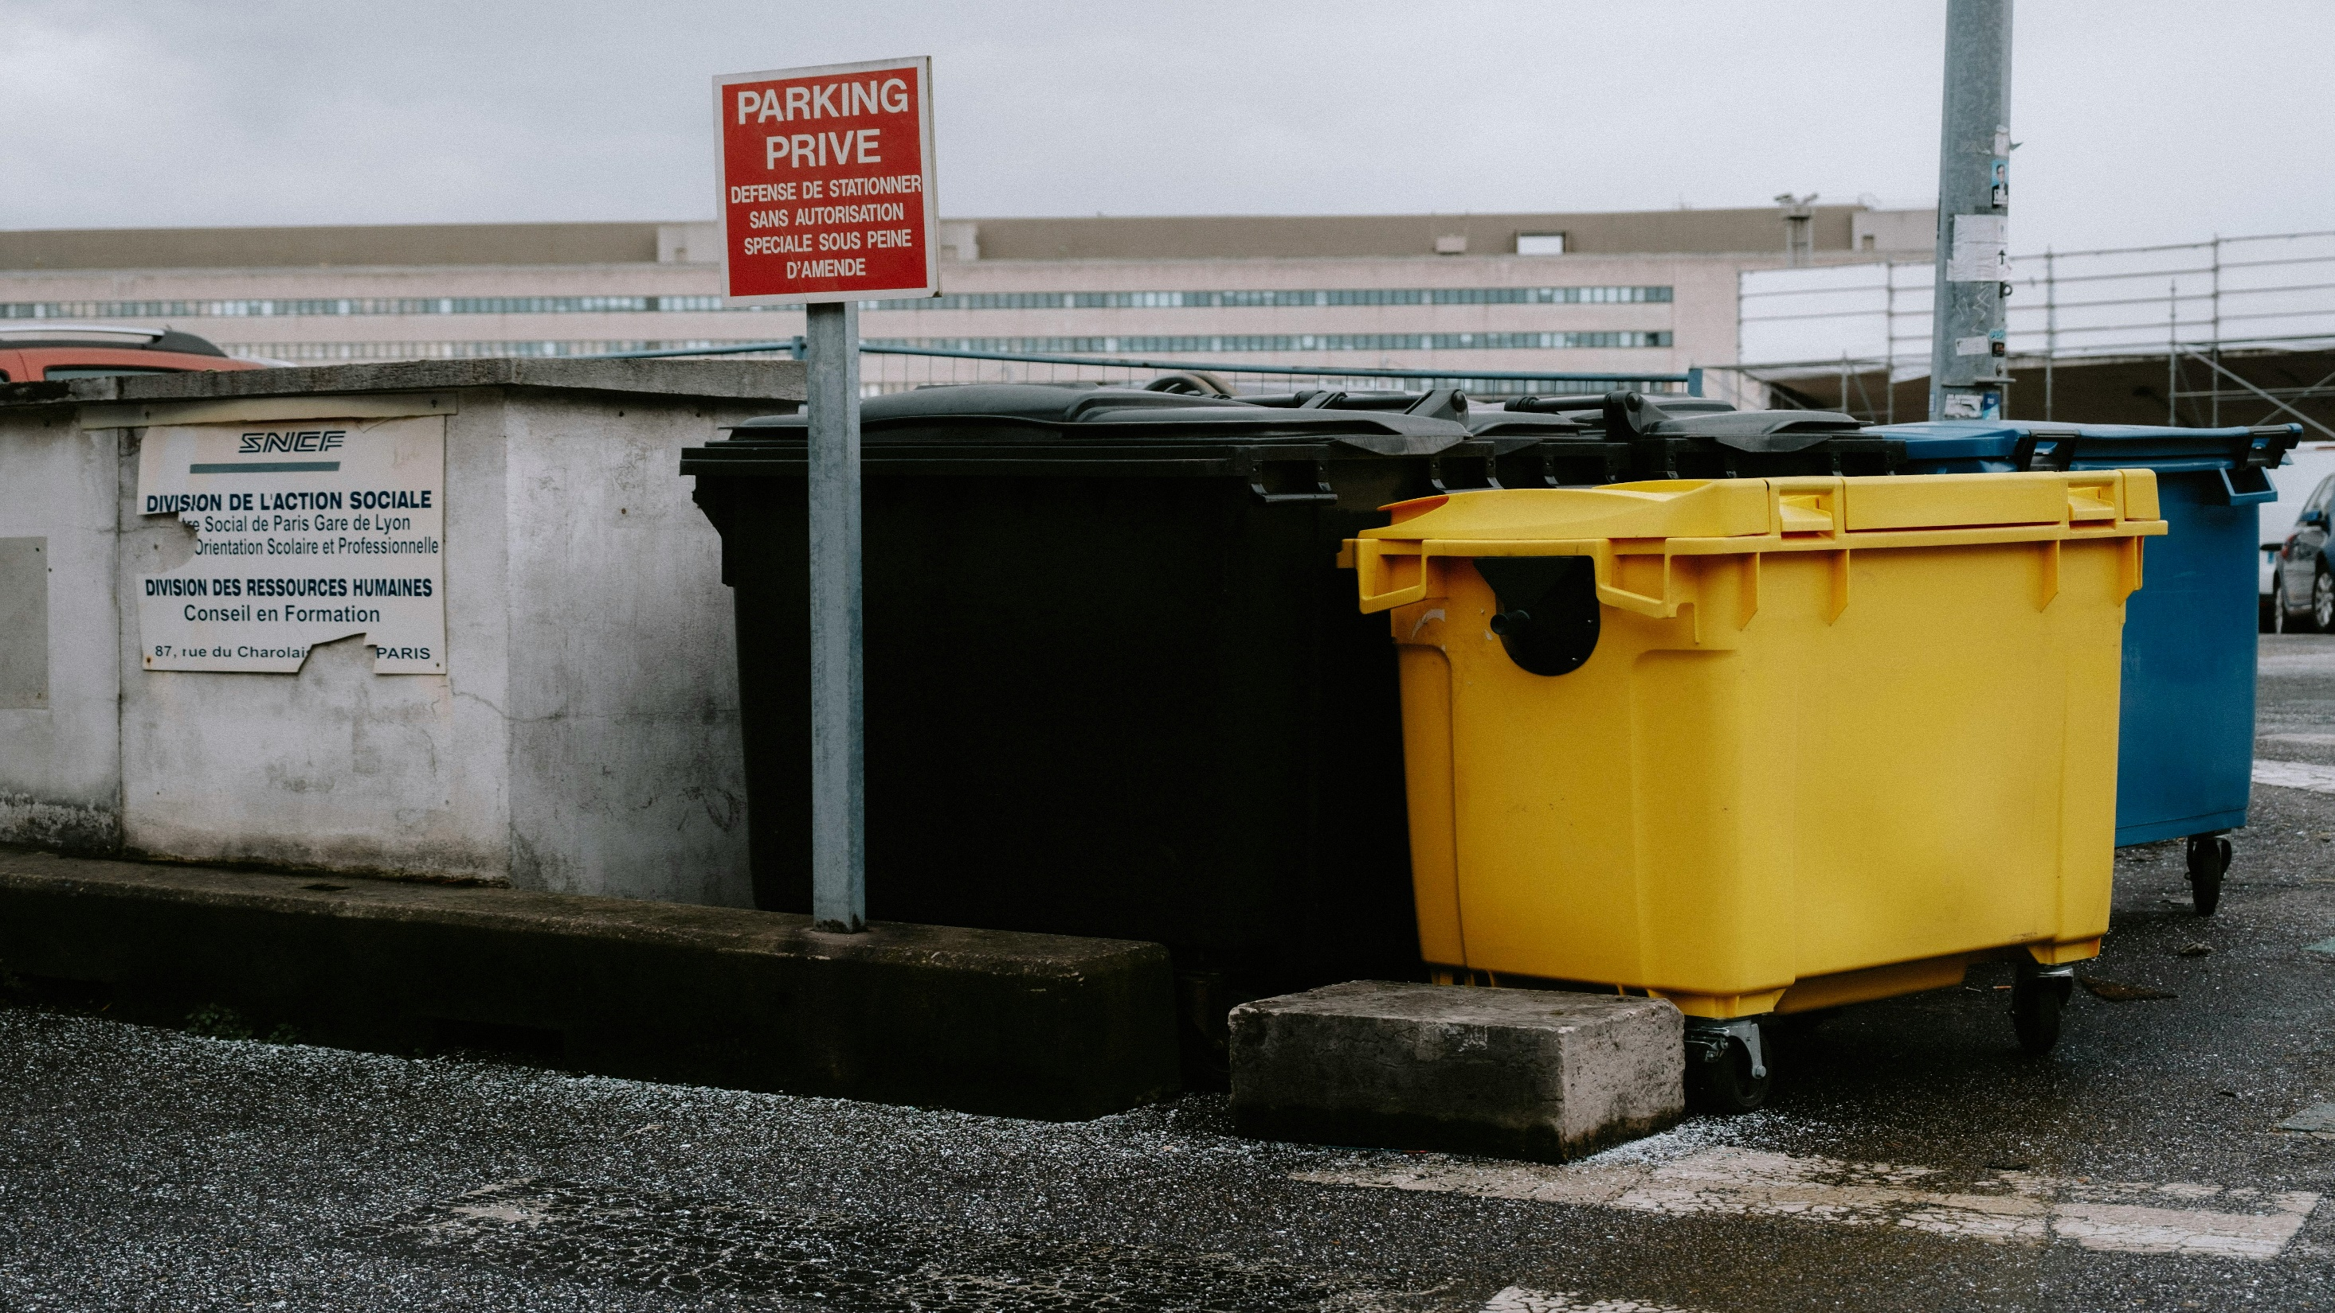
TAKYI PRINCE KOBINA
Quenching Thirst, Preserving Tomorrow
Providing sustainable water supply and waste management solutions to safeguard the environment and promote a healthier future.

Slide 2

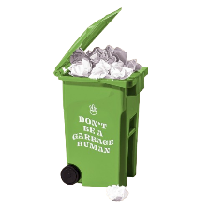
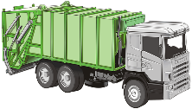
Installing and maintaining Filtration Systems to improve water quality and safety.
Installing and maintaining Filtration Systems to improve water quality and safety.
LOREM IPSUIM
LOREM IPSUIM
LOREM IPSUIM
Installing and maintaining Filtration Systems to improve water quality and safety.

Slide 3
Installing and maintaining Filtration Systems to improve water quality and safety.
LOREM IPSUIM
LOREM IPSUIM
LOREM IPSUIM
Installing and maintaining Filtration Systems to improve water quality and safety.
Installing and maintaining Filtration Systems to improve water quality and safety.

